Slide 1


Recording, Analyzing and Using Physiological Signals in Psychology
Dominique Makowski
D.Makowski@sussex.ac.uk
04/2024 Workshop at

Slide 2
Psychophysiology Measuring, analysing, and investigating the role of bodily signals

Slide 3

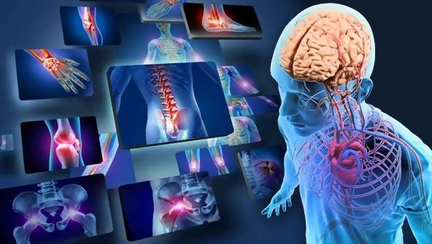
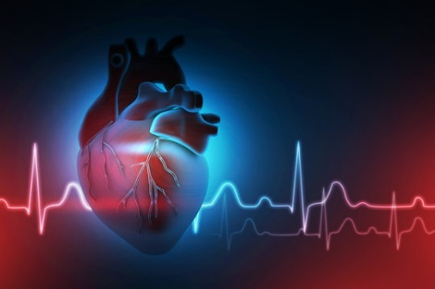
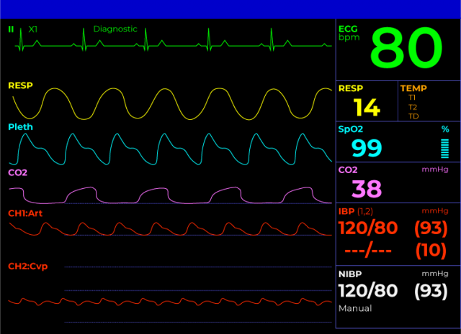
Measure the unmeasurable
Body is « infinitely » complex (multiscale interactions)
Intractable construct
Separate into « organs » or « systems »
E.g., cardiovascular, respiratory, gastric systems
Measure one type of « activity »
E.g., The electrical activity related of the heart muscles
Transform
E.g., filter, remove artifacts
Summarize
E.g., average, SD, count
Descriptors (= physiological indices)
E.g., « mean heart rate », « number of eye blinks »

Slide 4
Timescales of physiological variability
Measured physiological indices can vary depending on…
Interindividual (trait)
“stable”
BMI
Age
Emotion Regulation
Cognitive Control
Mood (state/trait)
Sense of reality
Personality
Mindfulness trait
…
“Dispositional characteristics”
Intraindividual (States) – Slow dynamics
30s – few hours
Circadian rhythms
Affective states
Anxiety
Stress
Attention
Engagement
Focus
Cognitive load
Resting-state
…
“State-related” / Block design paradigms
Intraindividual (Events) – Fast dynamics
0-10s
Emotional stimuli
Attentional engagement and control
Decision making tasks
…
“Event-related” paradigms
Intergroup
Species
Illnesses
Physical
Mental (Critchley et al., 2023)
…
Critchley et al. (2023). Cardiac interoception in patients accessing secondary mental health services: A transdiagnostic study. Autonomic Neuroscience, 245, 103072.

Slide 5
Physiological Indices
Physiological signals (aka bodily signals, biosignals): specific type of activity of an organ measured over time
Physiological indices (aka “features”) used are the end-result of a complex process of digitalization and simplification
They are imperfect summaries of specific aspects of the activity of a subset of organs of the body
BUT they are useful!
+ On-going improvements:
More comprehensive recordings
e.g., concurrent ECG, EDA, RSP, EEG
New measures
e.g., EGG, iEEG, mobile MEG, remote PPG
New processing approaches/algorithms offer new insights
e.g., fractal physiology

Slide 6
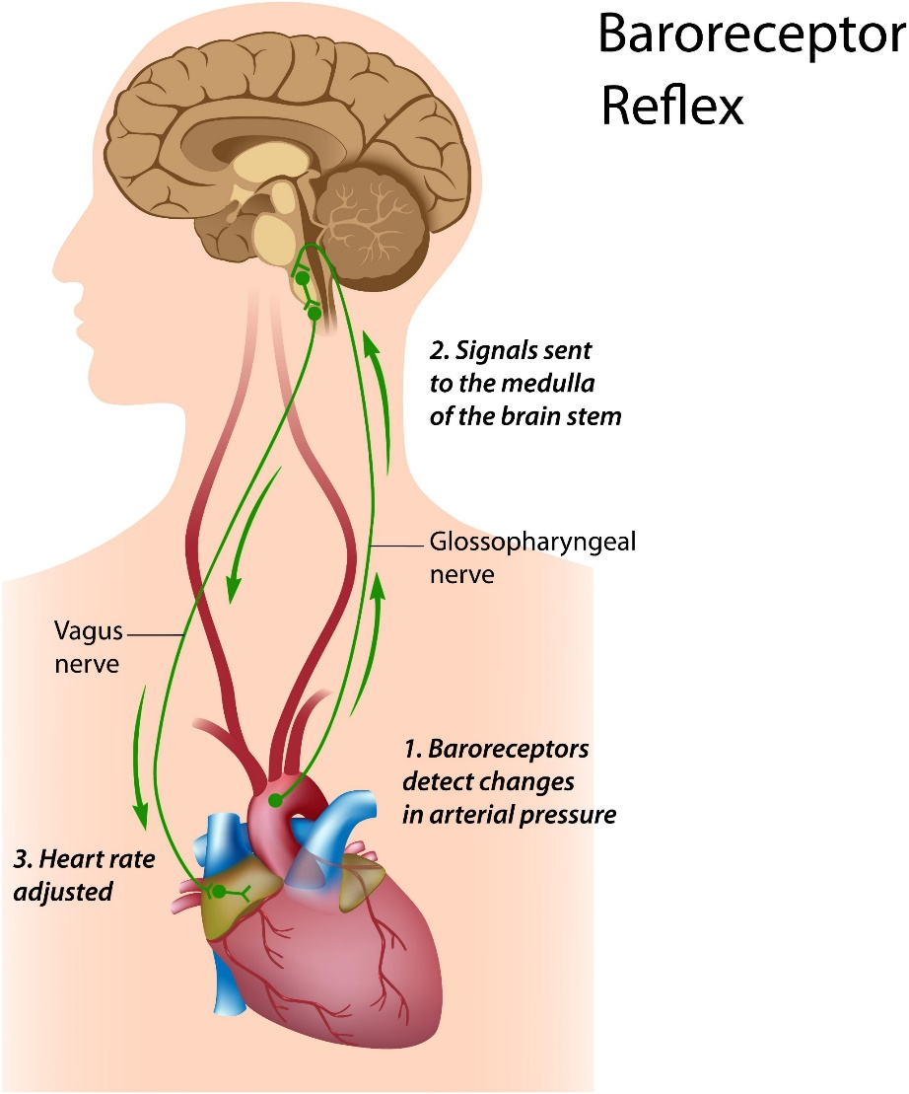
Top-down or Bottom-up?
Dependent variable ~ Independent Variable
E.g., Reaction Time ~ Experimental Condition
Adding physiological indices… where?
Heart rate ~ Condition
Reaction time ~ Heart Rate
Example: Cardiac Activity - Heart Rate (HR)
Top-down influences
Rapid changes: autonomic nervous system (ANS): adaptive system (influenced by cognition)
Slow changes: circadian rhythms, sleep cycles, metabolism, and changes in body temperature and hormonal systems
Bottom-up influences
Most cognitive processes take into account the bodily state (heart rate, cardiac phase, …)
Constant Interaction between the body and the brain
Distinction between cause and effect difficult in practice

Slide 7
Reactive vs. Predictive Physiology
Physiological Indices
(e.g., changes of heart rate, skin conductance amplitude, respiration phase, …)
Reactive (to the world)
physiological index ~ independent variable
Predictive (of future/ongoing behaviour)
dependent variable ~ physiological index
Event-related
Dynamic
State-related
Metastable
Heart Rate Variability
Respiration Rate Variability
Number of Skin Conductance Responses
…
Heart Rate Change
Respiration Rate Change
Respiration Amplitude Change
Skin Conductance Response Amplitude
…
Heart Rate
Cardiac Phase
Respiration Rate
Respiration Phase
Skin Conductance Level
…

Slide 8

As a researcher…
For each type of physiological signal (e.g., ECG, EDA, RSP, …), develop a knowledge and understanding of the existing indices
Their (mathematical) definition
Category and use-cases (reactive vs. predictive)
Limitations (they are imperfect summaries)
Selection of appropriate indices for the goals at hand

Slide 9
Quizz
True / False?
Physiological indices are accurate descriptors of specific physiological processes.
There is no difference in the overall value of physiological indices between any pathological group (e.g., Illness vs. Healthy).
After a « 3-2-1-go », my participants are instructed to stay still with their eyes closed during 10min. Are event-related indices likely to be appropriate to analyze this paradigm?
The participant’s current value of heart rate precisely when a stimulus appear on the screen is rather a reactive or a predictive index?

Slide 10
Electrodermal Activity (EDA)

Slide 11
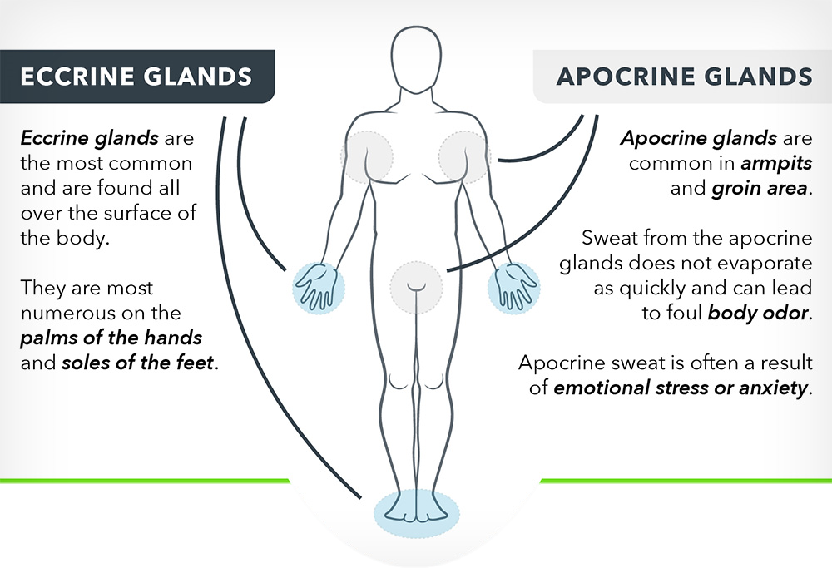
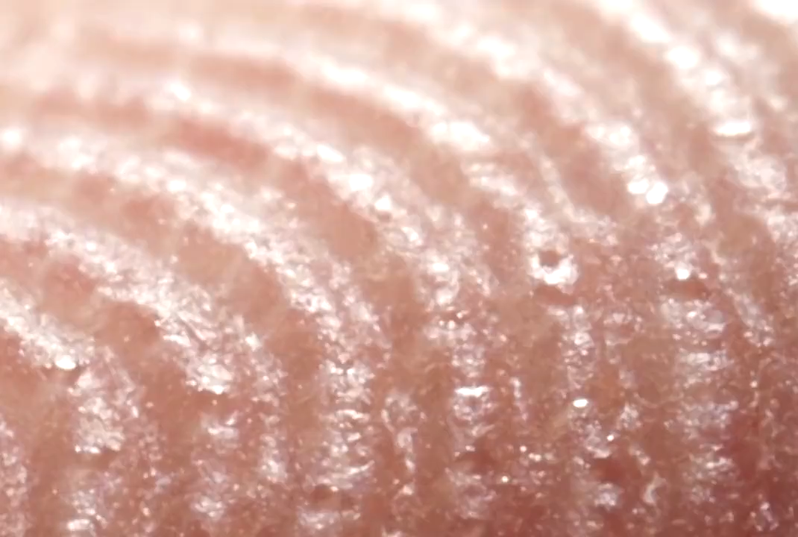
Electrodermal Activity (EDA)
Electrodermal activity (EDA)
≈ Skin Conductance Response (SCR)
≈ Galvanic Skin Response (GSR)
Quantifies the electrical conductance of the skin, which are influenced by the activity of sweat glands in response to autonomic nervous system (ANS) activity
1849 (Germany): Du Bois-Reymond observed that human skin was electrically active
1878 (Switzerland): Hermann and Luchsinger demonstrated a connection between EDA and sweat glands
1879 (France): Vigouroux working with emotionally distressed patients, was the first researcher to relate EDA to psychological activity
1888 (France): Féré demonstrated that skin resistance activity could be changed by emotional stimulation and that activity could be inhibited by drugs
1889 (Russia): Tarkhanov observed variations in skin electrical potentials in the absence of any external stimuli
1906 (Switzerland): C. G. Jung and his colleagues used EDA to evaluate the emotional sensitivities of patients to lists of words during word association. Jung was so impressed with EDA, he allegedly cried: "Aha, a looking glass into the unconscious!"
Sequeira, H., Deren, P., & Maitte, B. (2021). Los primeros días de la actividad electrodérmica / The early days of electrodermal activity. Anales de Psicología / Annals of Psychology, 37(3), 406–411. https://doi.org/10.6018/analesps.483051

Slide 12
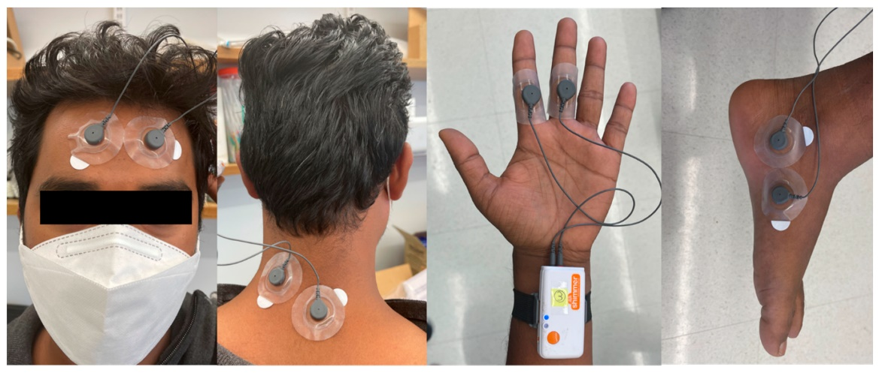
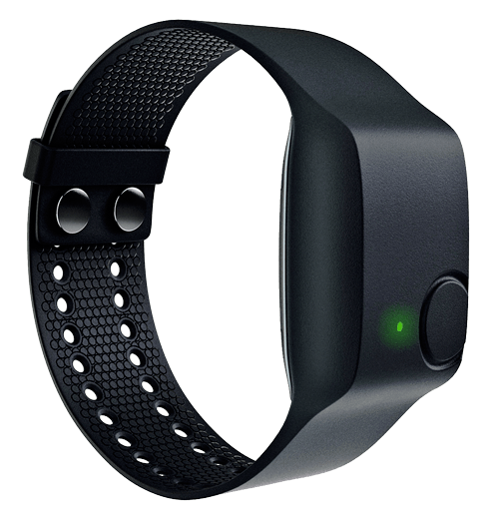
Electrodermal Activity (EDA)
Measured via the current difference of conductance between a + and a – electrode
Hands (fingers, palm, wrist)
Feet (useful in some contexts)
Affordable, easy to analyze
Increasing popularity beyond psychophysiology
Integration in wearable devices (e.g., smart watches)
EDA electrodes
Hossain, M. B., Kong, Y., Posada-Quintero, H. F., & Chon, K. H. (2022). Comparison of electrodermal activity from multiple body locations based on standard EDA indices’ quality and robustness against motion artifact. Sensors, 22(9), 3177.

Slide 13
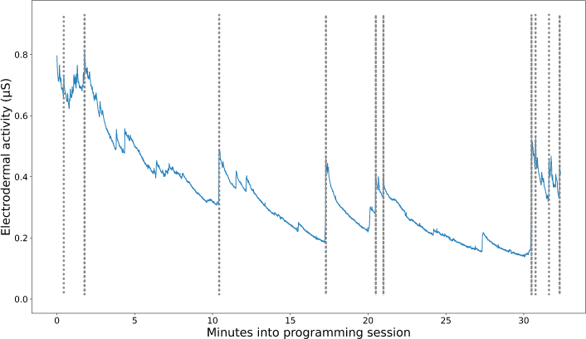
EDA signal(s)
Unit: micro-siemens “μS” (unit of electric conductance)
Recommended minimum sampling frequency: > 70 Hz (70 datapoints per second)
Long term “trends” (drifts) + fast spikes
minutes

Slide 14
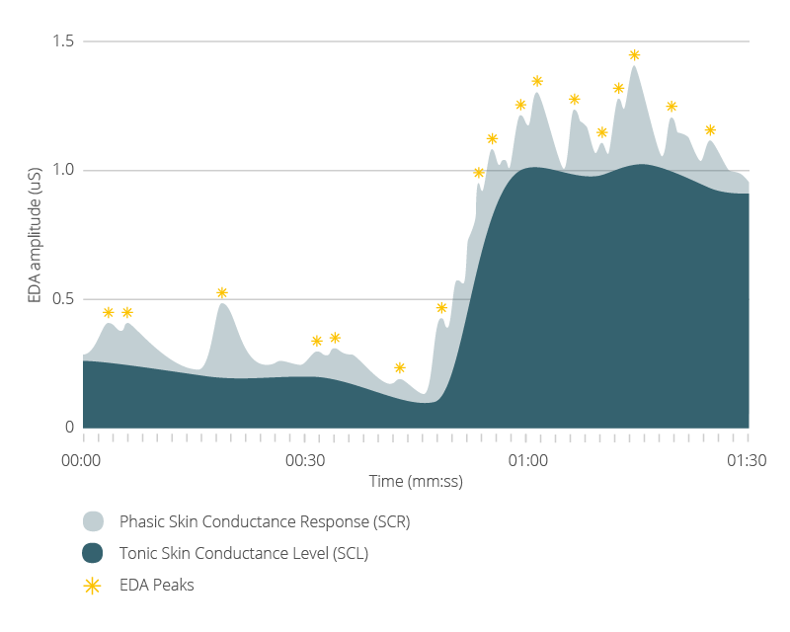
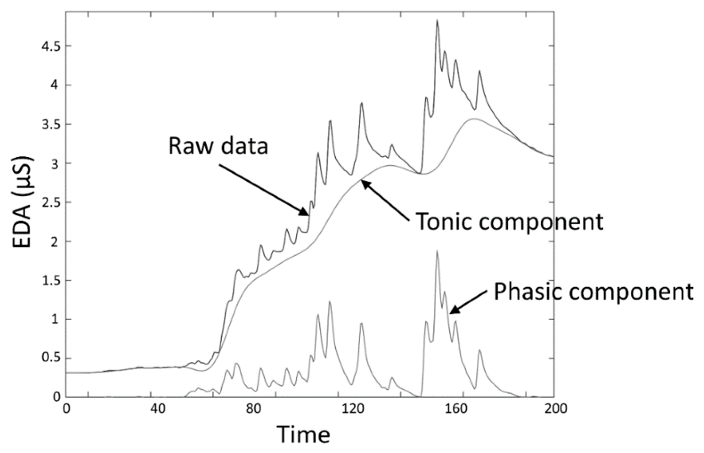
Phasic vs. Tonic Signal
EDA = Tonic + Phasic components
Tonic signal: Skin Conductance Level (SCL)
Slow changes driven by “background” processes such as thermoregulation and general arousal
Phasic signal: Skin Conductance Response (SCR)
Fast changes (peaks) reflecting sympathetic autonomic activity that is associated with emotion and attention
Signal decomposition: key signal preprocessing step

Slide 15
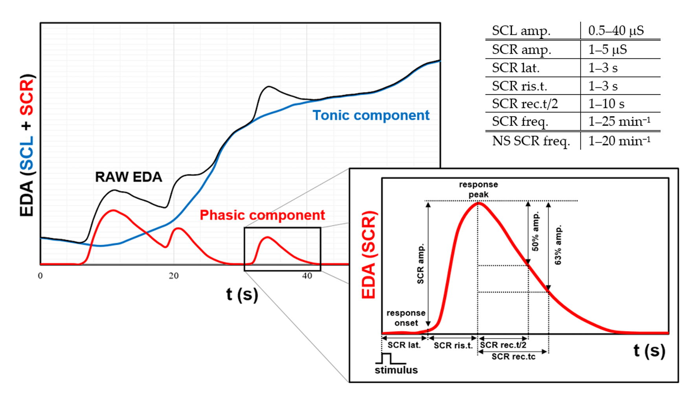
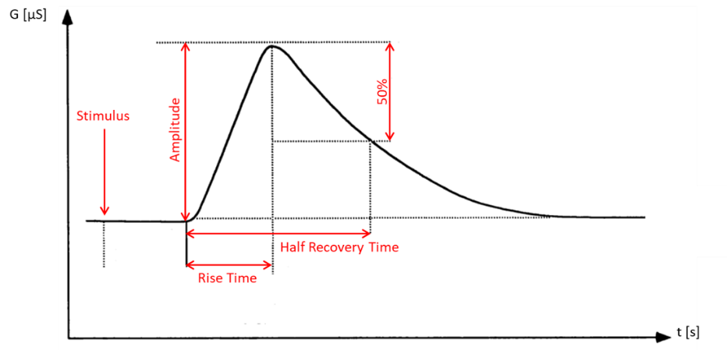
Indices
Most interesting EDA indices in psychophysiology are obtained from the phasic signal
« Peaks » of the Phasic component of EDA = Skin Conductance Responses (SCRs)
State-Related Indices
Number of peaks in a given interval / condition / task
Event-Related Features
Peak presence / absence (in each « trial »)
SCR characteristics
Amplitude (≠ EDA peak magnitude)
Latency (onset time)
Rise time
Recovery time (return to 50% of amplitude)
Limitations
Slow dynamics (3-8 seconds): not suited for fast-paced event-related paradigms
Transformation: log-transform sometimes applied

Slide 16
Caveats
Overall easy to measure, but
EDA is sensitive but not specific
Sensitive to movement
Cough, sneeze, sighs, deep breaths, …
Importance of ambient & skin temperature, hydration, …
Can introduce variability in experiments if not controlled
Habituation and long-term drift
Potential issues with long and repetitive experiments
Participants
Non-responders: Approximately 10% of participants are estimated to be non-responders (hypo-responsive) in terms of their EDA
Reasons unclear
Clinical groups: Pathologies related to hypo-responsiveness (e.g., schizophrenia). Cardiovascular abnormalities an, in some circumstances, produce rhythmic artefacts (spiking) in the EDA.
Hand dryness vs. palmar hyperhidrosis (excessive hand sweating) can introduce difficulties

Slide 17
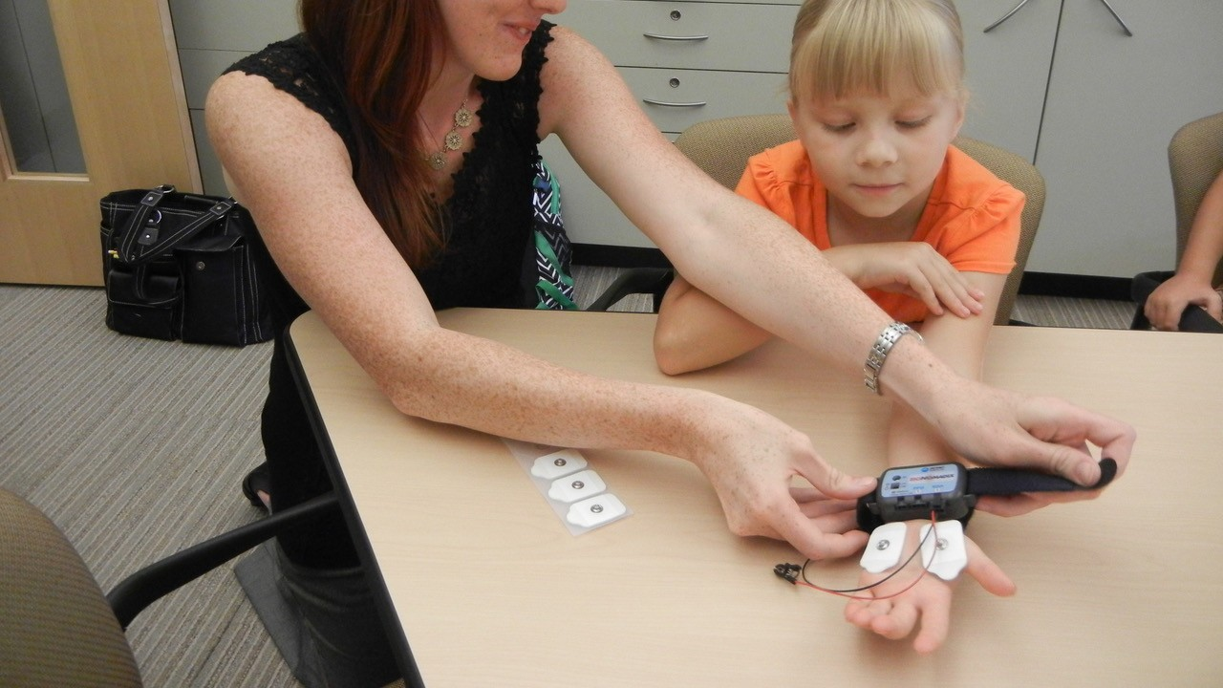
Application
EDA is unspecifically related to attention, arousal and emotion
Emotion research
Reaction to stress and emotional events
Emotion regulation
Cognitive research
Attention and arousal
Cognitive load and effort
Salience / detection (consciousness research)
Therapeutic practice
Biofeedback in CBT
Stress Management
Diagnostic (anxiety disorders)
Manipulation check
A task/condition was eliciting affective responses
A task/condition was difficult and effortful
A group is more “emotionally sensitive” in a given paradigm

Slide 18

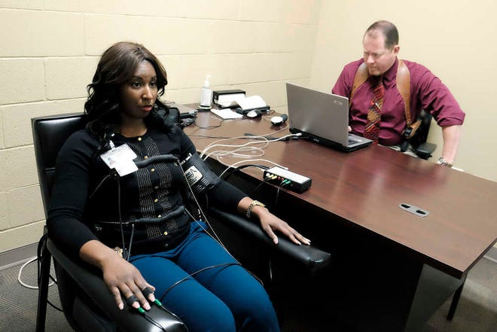
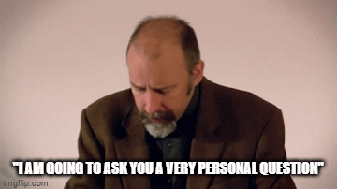
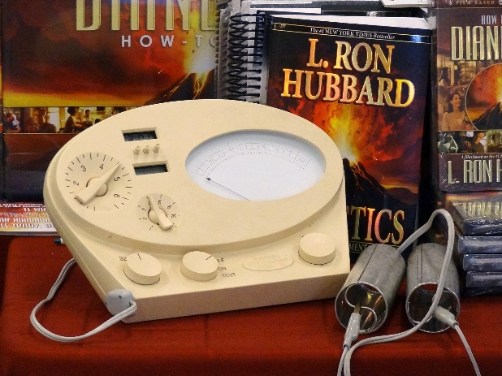
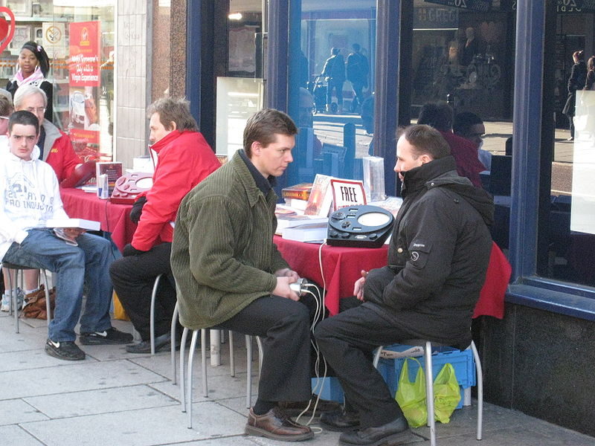
Alternative Usage
Marketing
Advertisement
Consumer research
Political counselling
Forensic
“Polygraph” (lie detector)
Well-being
Health / personal development programs & apps
E-meter (aka “electropsychometer”): Scientology
Misuse?
Notes:
E-meters are used by Scientology ministers known as "auditors". Scientology materials traditionally refer to the subject as the "preclear", although auditors continue to use the meter on subjects who are well beyond the "clear" level. The auditor gives the preclear a series of commands or questions while the preclear holds a pair of cylindrical electrodes ("cans") connected to the meter, and the auditor notes both the verbal response and the activity of the meter.
According to Hubbard, the E-meter is used by the operator for three vital functions:
To determine what process to run and what to run it on.^{[34]}
To observe how well the process is running.^{[35]}
To know when the process should be stopped.^{[36]}

Slide 19
Respiration (RSP)

Slide 20
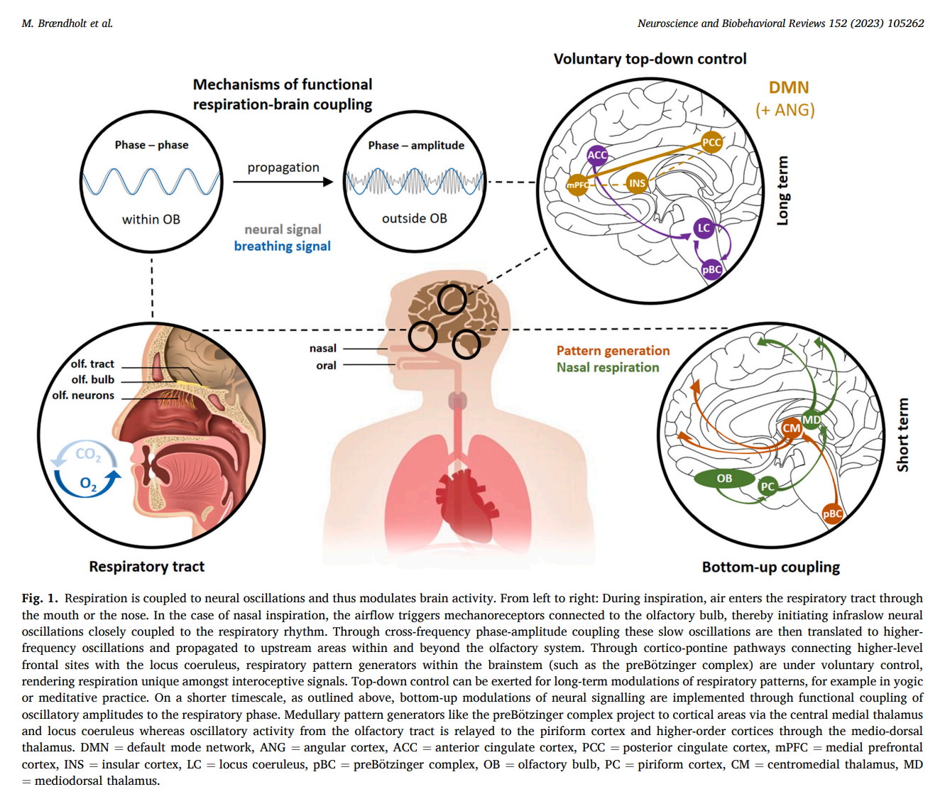
Neurophysiology
The brain structures controlling breathing and those sensing the resulting changes in airflow are intricately connected with the limbic system
Information about the respiratory state is widely available in subcortical and cortical brain regions
This gives us the potential to consciously adjust breathing to meet task-demands (e.g., exercise, singing), but may also allow respiratory-related signals to continuously and subconsciously influence cognitive functions (Johannknecht et al., 2022)

Slide 21
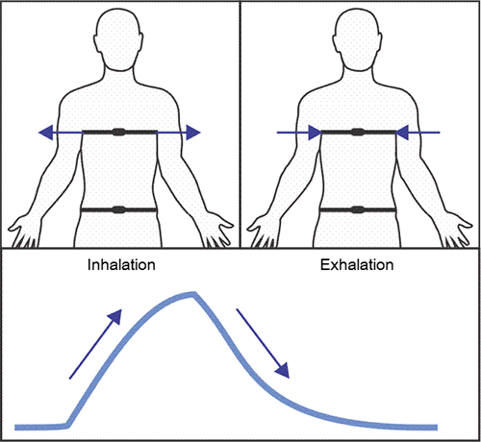
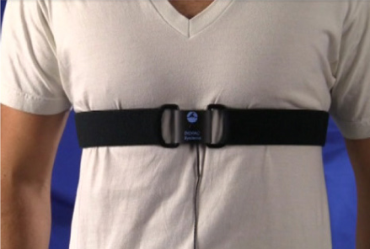
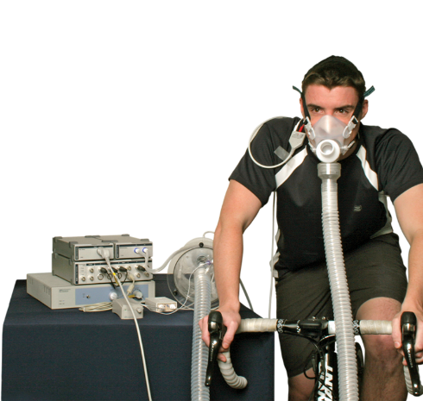
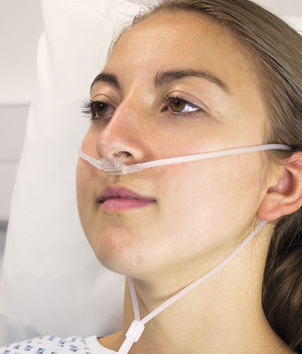
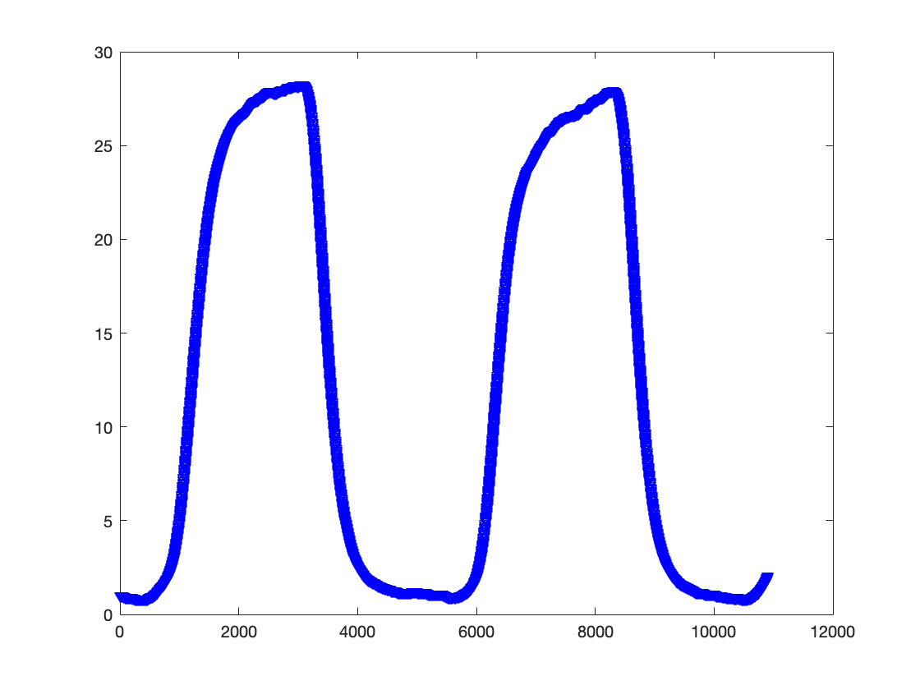
Respiration (RSP)
Misnomer
Respiration is the chemical process of gaz exchange that takes place at a cellular level and produces energy
Oxygen (O2) moves out of inhaled air and into blood hemoglobin. Carbon dioxide (CO2) extracted out of blood and exhaled
Breathing is the physical process of inhale and exhale air in and out of your lungs
Correct name is Ventilation (but respiration is still common)
Equipment
Respiration Transducer (“Respiration Belt”) records respiratory effort (= ventilation)
Respiration
Spirometer (air flow)
Nasal cannula / mask (gaz exchange)

Slide 22


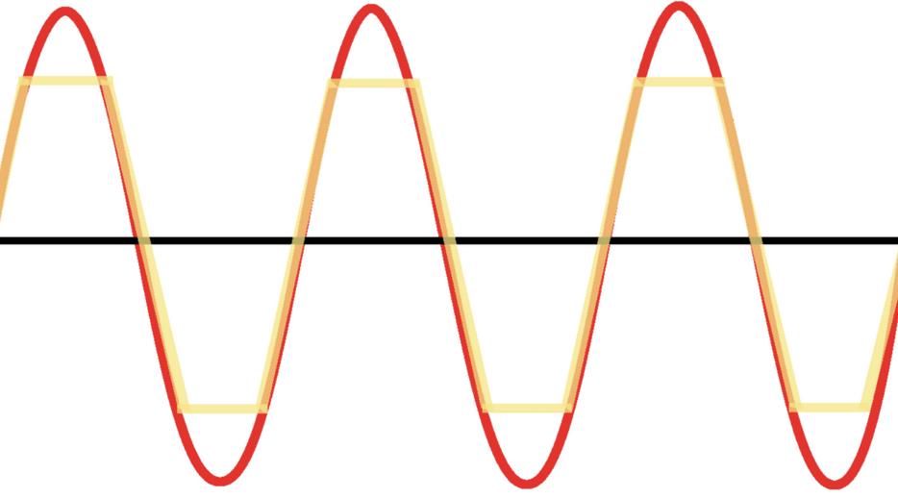
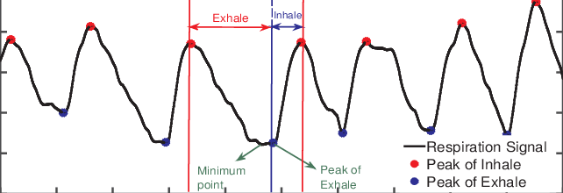
RSP with belt
Placement
Chest, bottom rib, abdomen…?
Belt can shift when participant sits versus lies
Breathing “style” variability (intra et interindividual)
Multiple belts?
Tighten the belt during maximum exhalation
Look for signal “clipping”: typically indicates belt too loose or too tight
Signal characteristics
Peaks and troughs
Inhalation phase: trough → peak (ascending)
Exhalation phase: peak → trough (descending)

Slide 23
RSP Indices
Key preprocessing step: peaks and troughs identification
Predictive Indices
Respiration phase: Inhalation / Exhalation
State-related Indices
Mean Amplitude
Mean Respiration rate (1 / distance between consecutive peaks)
Respiration Rate Variability (RRV)
Event-related Indices
Respiratory cycle characteristics
Amplitude
Symmetry
Rise time
…

Slide 24
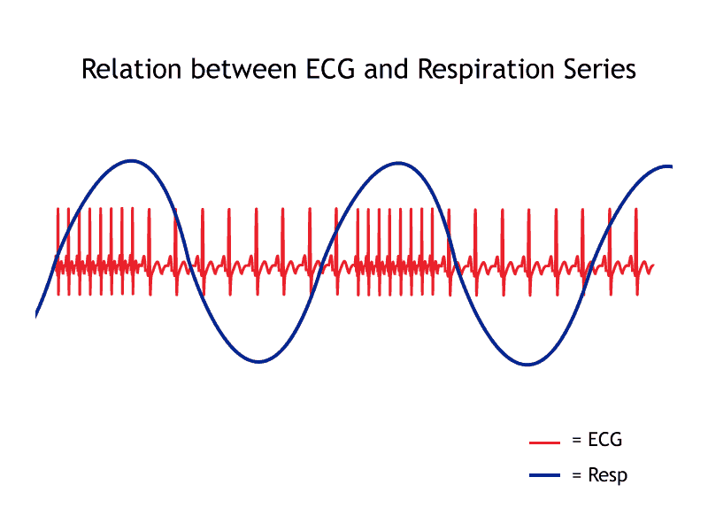
Respiratory Sinus Arrythmia (RSA)
Strong influence of breathing on heart rate
The heart rate increases during inhalation and decreases during exhalation
Demonstrates the tight coupling between different organs (cardiovascular and respiratory systems)
RSA is one of the mechanisms contributing to Heart Rate Variability (HRV), which can be used as a measure of the vagal tone (an index of how well the vagus nerve is working)
Low vagal tone is associated with aging and various negative outcomes such as poor mental and physical health, and poor emotional and attentional regulation in children (Graziano, 2013)

Slide 25
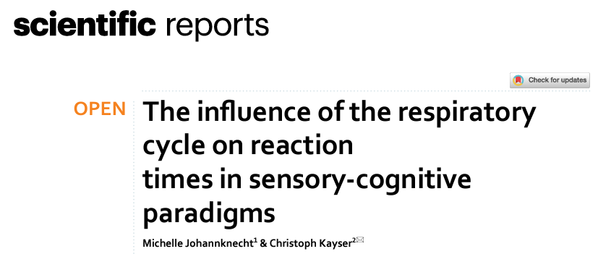
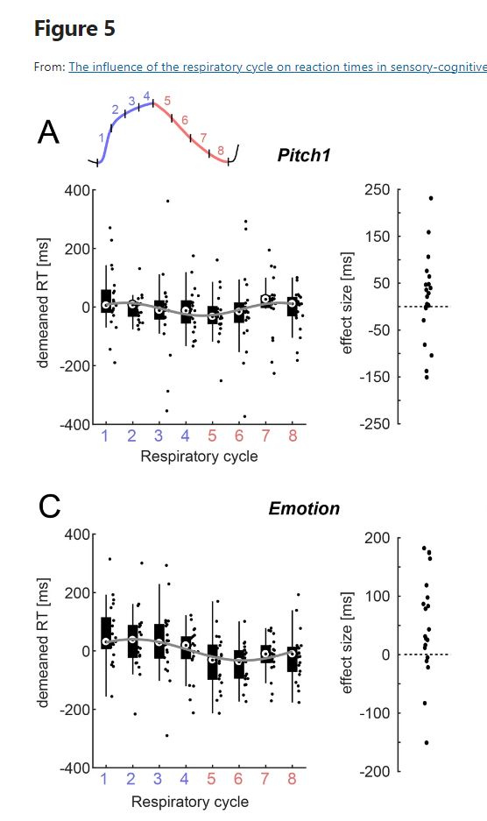
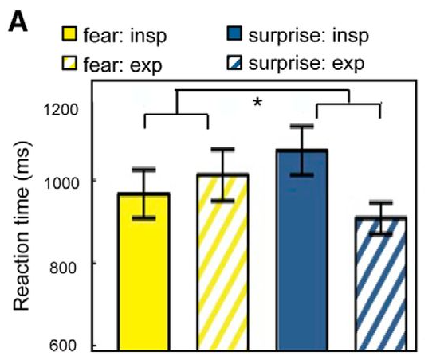
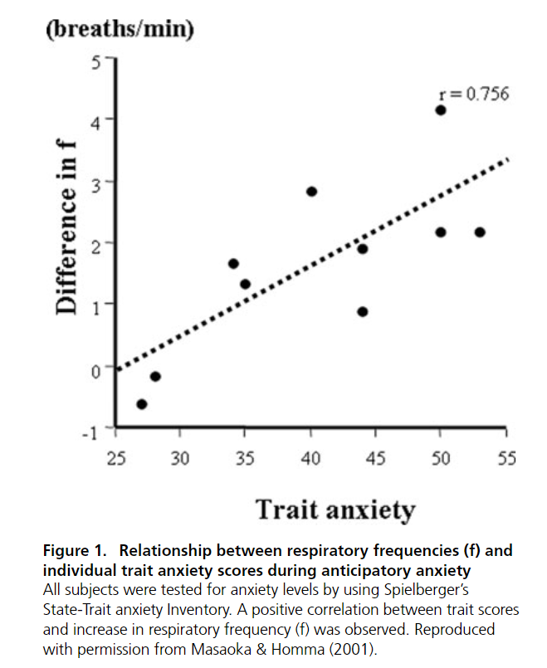
Application
Often used as an intervention target (meditation, relaxation…)
Paradoxically little research (compared to EDA and ECG)
But potentially future “hot” topic
Relationship to cognitive demand
Stressful tasks are linked to increased RRV (Vlemincx et al., 2011)
Respiratory Rate positively related to cognitive workload (Grassmann et al., 2016)
Reaction times (Johannknecht, 2022)
Depends on the task? On emotion?
Mood and Mental Health
Trait anxiety: increased respiration rate (Masaoka & Homma, 2001)
Panic disorder: increased hyperventilation and respiratory variability between attacks (Grassi et al., 2013)
Schizophrenia: increased respiration rate and amplitude (Akar et al., 2012)

Slide 26
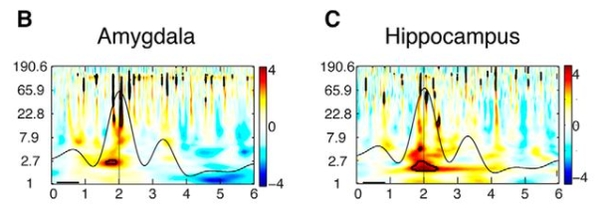
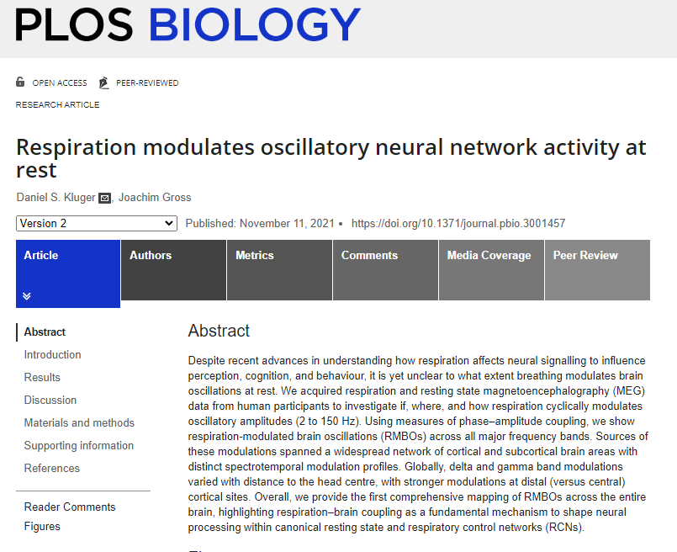
Influence on Brain Rythms
Intracranial EEG (iEEG)
Respiration modulated oscillations from theta (2–4 Hz) up to gamma frequencies (above 60 Hz) in the amygdala and hippocampus (Zelano, 2016)
Systematic coupling of respiratory phase to high-frequency gamma power at various cortical and subcortical sites (Herrero, 2018)
M/EEG
Effect of respiratory phase (inhalation vs. exhalation) on alpha and beta power within various brain regions (anterior and posterior cingulate cortices, temporo-parietal junction, and insula)
In particular, modulation of regions typically associated with the Default Mode Network (DMN)
Future
Relationship between respiratory rhythms and brain oscillations (respiratory-modulated brain oscillations - RMBOs) could serve as a potential biomarker in a variety of disorders (Brændholt, 2023)
Brændholt, M., Kluger, D. S., Varga, S., Heck, D. H., Gross, J., & Allen, M. (2023). Breathing in waves: Understanding Respiratory-Brain Coupling as a Gradient of Predictive Oscillations. Neuroscience & Biobehavioral Reviews, 105262.

Slide 27
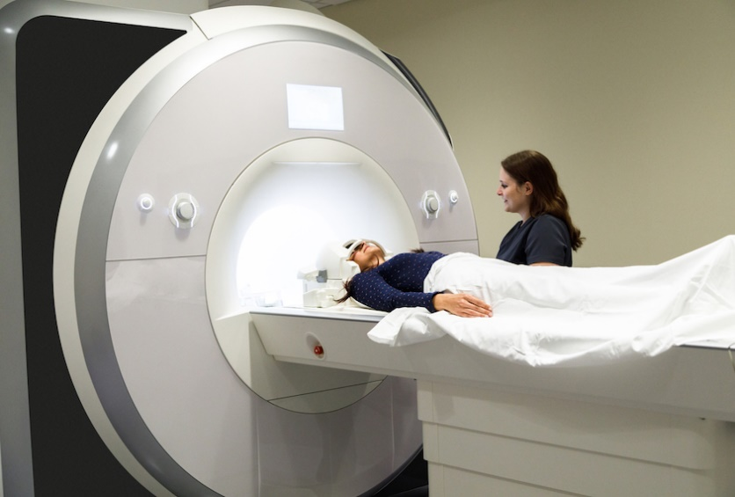
Alternative Usage
Neuroimaging
MRI denoising (cf. work by Molly G. Bright)
Breathing causes head to move in periodic manner
Chest position changes influence the B0 field homogeneity
Fluctuations in arterial blood gas levels influences vascular tone and therefore blood flow
Estimation of Respiratory Volume per Time (RVT), a product of respiratory volume and breathing rate, which can be used to identify lobal fMRI confounds of breathing
Health
Sleep monitoring (apnoea)
Sports psychology / Exercise physiology
Meditation with biofeedback
Altered states of consciousness (breathwork)
Forensic
“Polygraph” (lie detector)

Slide 28
Quizz
True / False?
Signal decomposition into phasic and tonic components is a key step of ECG analysis
Skin Conductance Level is the most important component of EDA in psychophysiology
A « respiration belt » records something else than respiration
Emotional processing only shows up in EDA
Recording RSP is invasive and expensive
RSA corresponds to « Resting State Assessment »
We can modulate our heart rate through breathing
More research is needed to understand the links between respiration and cognition

Slide 29

Thank you
Dominique Makowski
D.Makowski@sussex.ac.uk

